Slide 1
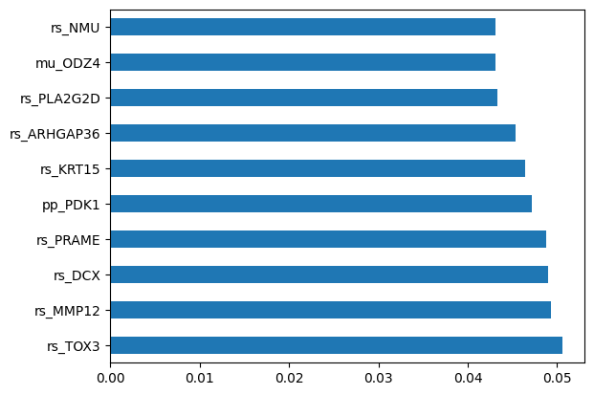
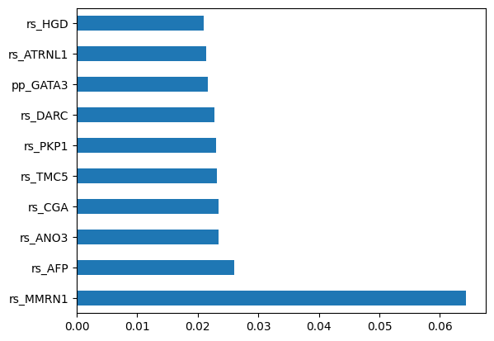
PREDICTING OUTCOMES OF BREAST CANCER PATIENTS
Urmee D., Chloe S., Anthony T., Chiemeka N., Maitrayee D.
BREAST CANCER BACKGROUND
METHODS
DISCUSSION
QUANTILE NORMALIZATION
Overall, we see that the precisions for the died class are significantly lower than the survived class, most likely due to the imbalance in the data. Through data augmentation and sampling methods, we hope to address this limitation in the future.
The high precisions of the tuned ANN and Random Forest indicate that these methods are viable options for predicting patient outcomes.
More prevalent in females
In women with cancer, 1/3 are breast cancer
IDC: 1st most common
75-80%
ILC: 2nd most common
10-15%
Incidence rates have increased
>40,000 individuals die every year
Ranked the gene of each sample by magnitude
Calculated the average value for the genes in the same rank
Substituted values of all the genes in that rank with average value
After the prior steps have been completed, the genes are then reordered back into their original order.
MACHINE LEARNING CLASSIFIERS
Class | Precision | Recall | F-1 Score
Died | 0.266 | 0.285 | 0.275
Survived | 0.920 | 0.913 | 0.916
SVM
Linear SVM used to find the best hyperplane that separates the survived and died classes
Performance statistics for linear SVM
Class | Precision | Recall | F-1 Score
Died | 0.375 | 0.642 | 0.473
Survived | 0.957 | 0.881 | 0.918
DATASET DESCRIPTION
ANN
Multilayer perceptrons (MLPs) are a class of fully connected artificial neural networks (ANNs)
Used MLPs with 3 hidden layers, with a maximum of 50 iterations
Tuned hyper params
Performance statistics for untuned MLP
705 breast cancer samples.
611 patients survived, 94 died
Four different omics data types:
cn: copy number variations (n=860)
mu: mutations (n=249)
rs: gene expression (n=604)
pp: protein levels (n=223)
Class | Precision | Recall | F-1 Score
Died | 0.5 | 0.214 | 0.3
Survived | 0.918 | 0.976 | 0.946
Figure 1. Top 10 important features for linear SVM
Decision Trees
Determines classification through a series of yes and no decisions regarding certain characteristics gathered from training
Used a max depth of 70
Performance statistics for tuned MLP
Class | Precision | Recall | F-1 Score
Died | 0.2 | 0.285 | 0.235
Survived | 0.917 | 0.874 | 0.895
KNN and Naive Bayes
KNN determines classification using “lazy evaluation” essentially collecting of census of k number of data points nearest to it by some metric classifying based on how the majority are classified
Used K = 7
Naive Bayes determines classification based on a number of independent probabilities
Used Multinomial
Performance statistics for Decision Tree
Class | Precision | Recall | F-1 Score
Died | 0.0 | 0.0 | 0.0
Survived | 0.901 | 1.0 | 0.9478
RESEARCH QUESTION
Figure 2. Top 10 important features for Decision Tree
Performance statistics for KNN
Can ML techniques be used to accurately predict patient outcomes based on omics data?
Class | Precision | Recall | F-1 Score
Died | 0.375 | 0.643 | 0.474
Survived | 0.957 | 0.882 | 0.918
REFERENCES
Performance statistics for Naive Bayes
Wright, P. (2023, March 21). Invasive ductal carcinoma (IDC). Invasive Ductal Carcinoma (IDC) | Johns Hopkins Medicine. Retrieved May 1, 2023, from https://www.hopkinsmedicine.org/health/conditions-and-diseases/breast-cancer/invasive-ductal-carcinoma-idc#:~:text=Invasive%20ductal%20carcinoma%2C%20also%20known,of%20all%20breast%20cancer%20diagnoses.
Ciriello, G., et al. (2015). Comprehensive Molecular Portraits of Invasive Lobular Breast Cancer. In Cell (Vol. 163, Issue 2, pp. 506–519). Elsevier BV. https://doi.org/10.1016/j.cell.2015.09.033
Mayo Foundation for Medical Education and Research. (2022, May 18). Invasive lobular carcinoma. Mayo Clinic. Retrieved May 1, 2023, from https://www.mayoclinic.org/diseases-conditions/invasive-lobular-carcinoma/symptoms-causes/syc-20373973#:~:text=Invasive%20lobular%20carcinoma%20is%20a,other%20areas%20of%20the%20body.
https://www.breastcancer.org/types/invasive-lobular-carcinoma
American Cancer Society. (2022). Breast cancer. https://www.cancer.org/cancer/breast-cancer.html
National Cancer Institute. (2022). Breast cancer genetics. https://www.cancer.gov/types/breast/hp/breast-genetics-qa
Perou, C. M., Sorlie, T., Eisen, M. B., van de Rijn, M., Jeffrey, S. S., Rees, C. A., Pollack, J. R., Ross, D. T., Johnsen, H., Akslen, L. A., & Fluge, Ø. (2000). Molecular portraits of human breast tumours. Nature, 406(6797), 747-752. https://doi.org/10.1038/35021093
Trastuzumab. (Herceptin) | Cancer information | Cancer Research UK. (2023, March 29). Retrieved May 1, 2023, from https://www.cancerresearchuk.org/about-cancer/treatment/drugs/trastuzumab#:~:text=Trastuzumab%20is%20a%20targeted%20cancer,stomach%20(gastro%20oesophageal%20junction).
Bianchini, G., Balko, J. M., Mayer, I. A., Sanders, M. E., & Gianni, L. (2016). Triple-negative breast cancer: challenges and opportunities of a heterogeneous disease. Nature Reviews Clinical Oncology, 13(11), 674-690. https://doi.org/10.1038/nrclinonc.2016.66
Random Forest
Creates many decision trees, each based on a random subset of genes and samples
Trees are combined to produce a consensus prediction for each sample
Class | Precision | Recall | F-1 Score
Died | 0.75 | 0.316 | 0.444
Survived | 0.923 | 0.987 | 0.954
Performance statistics for Random Forest

